Slide 1
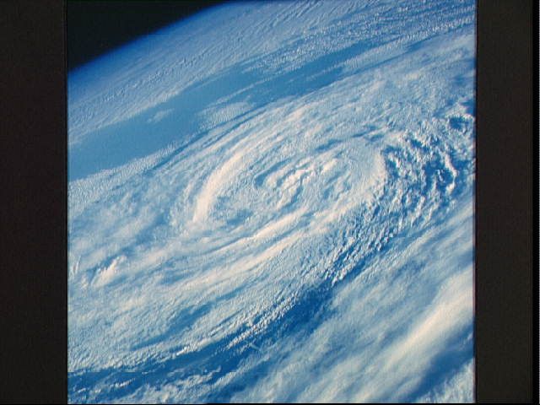
CHAPTER 4
ATMOSPHERIC
AND
OCEANIC
CIRCULATIONS

Slide 2
Atmospheric and Oceanic Circulations
Quick Preview
Wind Essentials
Driving Forces Within the Atmosphere
Atmospheric Patterns of Motion
Oceanic Currents

Slide 3
Earth’s Atmospheric Circulation
Earth’s atmospheric circulation
Transfer mechanism for both energy & mass
Mount Pinatubo’s eruption of 1991
Injected enormous quantities of aerosols and dust into the stratosphere; stratospheric cloud persisted for 3 years after the eruption. Ash is silica = glass
Atmospheric albedo increased by 1.5%
Led to a decrease in global temp. of 0.6 degrees C
Imbalance between equatorial energy surpluses & polar energy deficits generates earth’s weather patterns
Ocean currents produced

Slide 4
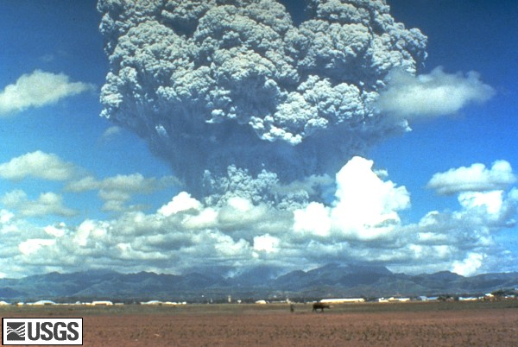
10 km³ of magma, and 20,000,000 t of SO₂, bringing vast quantities of minerals and metals to the surface environment, the ash cloud from the volcano covered an area of some 125,000 km²

Slide 5
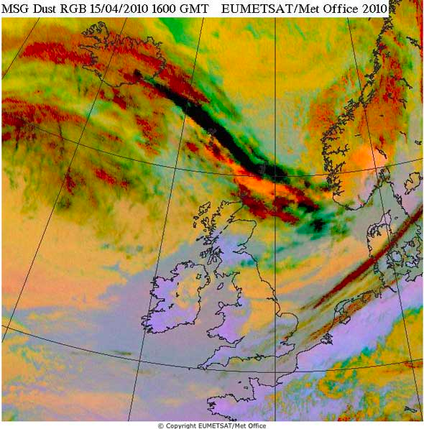
Satellite image of Icelandic Volcano’s
ash column
Notes:
Wind is pushing ash cloud towards europe

Slide 6
Wind Essentials
Categorized at 3 levels:
Primary circulation - general
Secondary circulation
Migratory high-pressure and low-pressure systems
Tertiary circulation
Local winds and temporal weather patterns
Meridional winds - principal movement north or south along meridians
Zonal flows – winds moving east or west along parallels

Slide 7
Wind Essentials
Air Pressure and Its Measurement
Product of the changes in temperature & density of a mass of air
Mercury barometer
Normal sea-level pressure: 1013.2 mb (101.32 kPa) of mercury (force per square meter of surface area)
Aneroid barometer
High pressure – 1050 mb
Low pressure – 980 mb e.g. hurricanes
Notes:
Explaining how the barometer works
Millibar is an isobar

Slide 8
Wind Essentials
Wind: Description and Measurement
Horizontal movement of air across Earth’s surface
Differences in air pressure between one location and the next. High or Low system
Anemometer; measures wind speed
Winds named for the direction from which winds originate
Global Winds

Slide 9
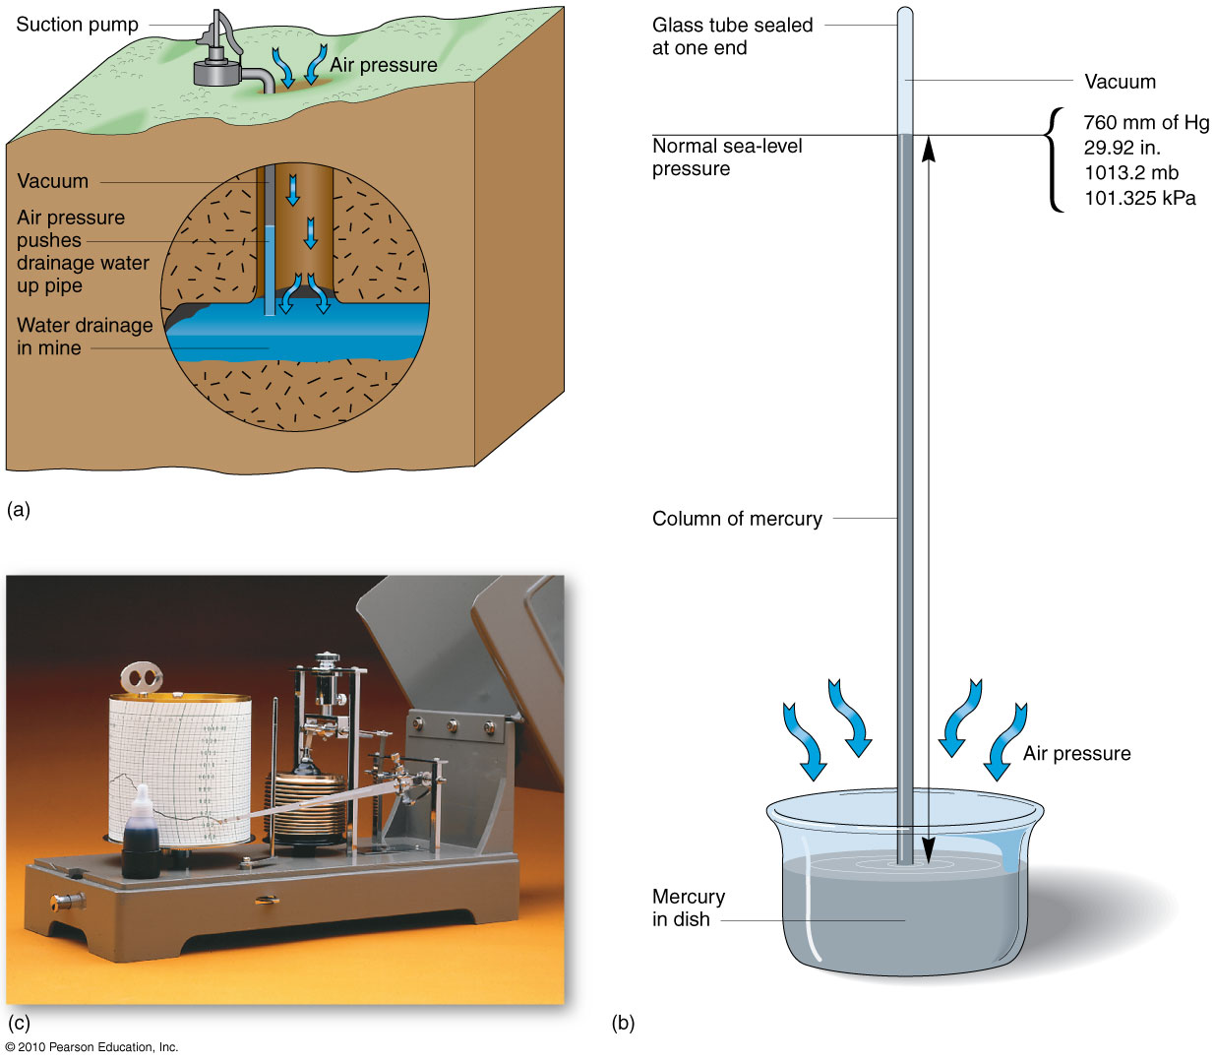
Barometers
Figure 4.2
Christopherson, Elemental Geosystems, Sixth Edition
Copyright © 2010 Pearson Education, Inc.

Slide 10
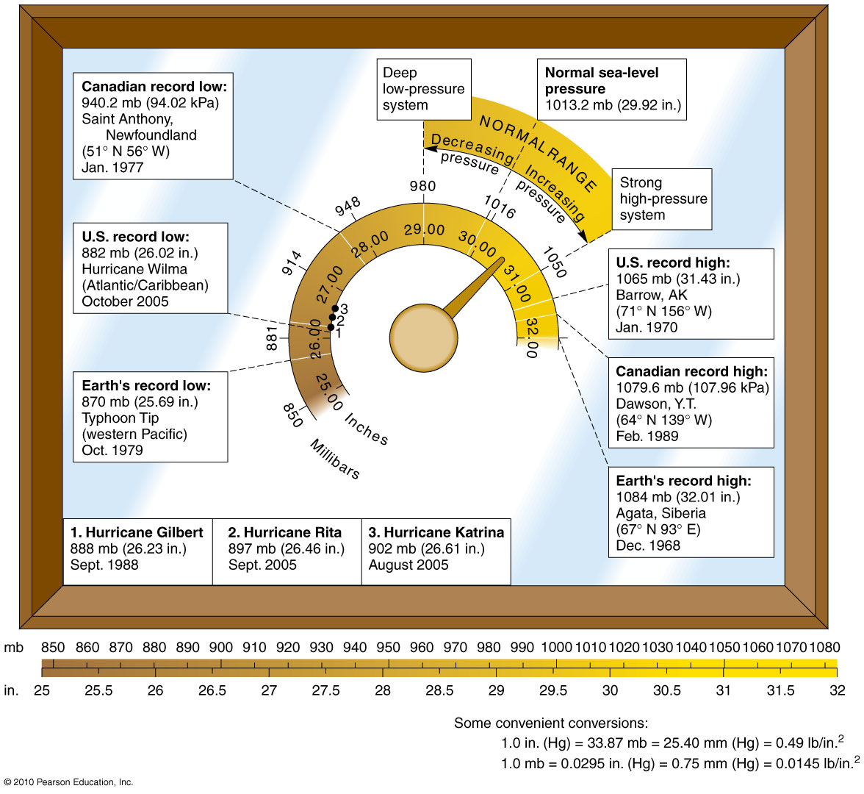
Air Pressure Readings
Figure 4.3
Christopherson, Elemental Geosystems, Sixth Edition
Copyright © 2010 Pearson Education, Inc.

Slide 11
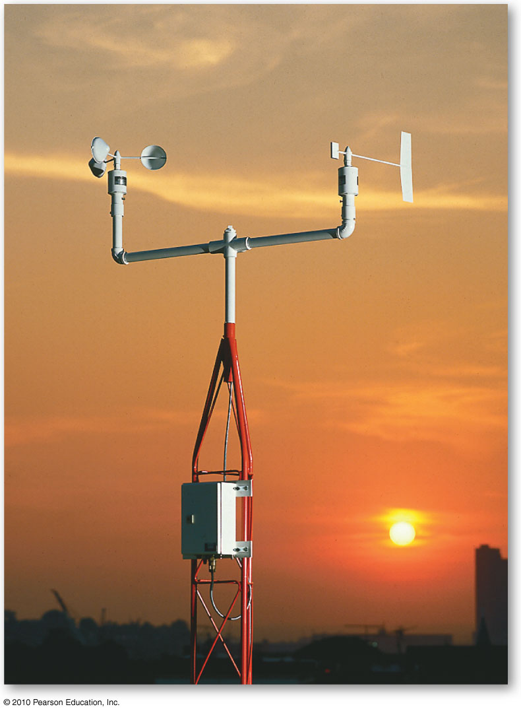
Wind Vane and Anemometer
Instruments used to measure wind speed (anemometer) and wind direction ( wind vane)
Wind horizontal movement air turbulence adds wind updrafts and downdrafts –vertical component
Figure 4.4
Christopherson, Elemental Geosystems, Sixth Edition
Copyright © 2010 Pearson Education, Inc.

Slide 12
Global Winds
Seasat – 1st Earth-orbiting satellite designed for remote sensing of the Earth’s oceans
Spacecraft measures height above the ocean surface
measure wind speed and direction
measure sea surface temperature
identify cloud, land and water features
monitor the global surface wave field and polar sea ice conditions.

Slide 13
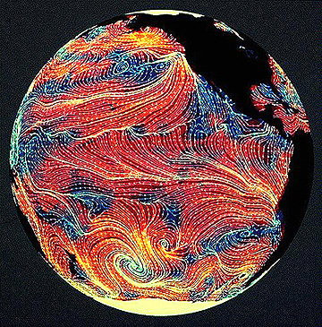
Data from the scatterometer on Seasat helped to generalize wind patterns over the Pacific Ocean, shown in this image:
Notes:
Red = warm wet blue = cold dry

Slide 14
Driving Forces within the Atmosphere
4 forces determine both speed and direction of winds
Gravitational force
equally compresses the atmosphere near the ground worldwide
Remember: density decreases with altitude
Geotrophic =
No gravity no atmosphere

Slide 15
Driving Forces Within the Atmosphere
Pressure Gradient Force
drives wind from areas of high barometric pressure to areas of lower barometric pressure
this movement produces winds
pressure gradient determines wind speed

Slide 16
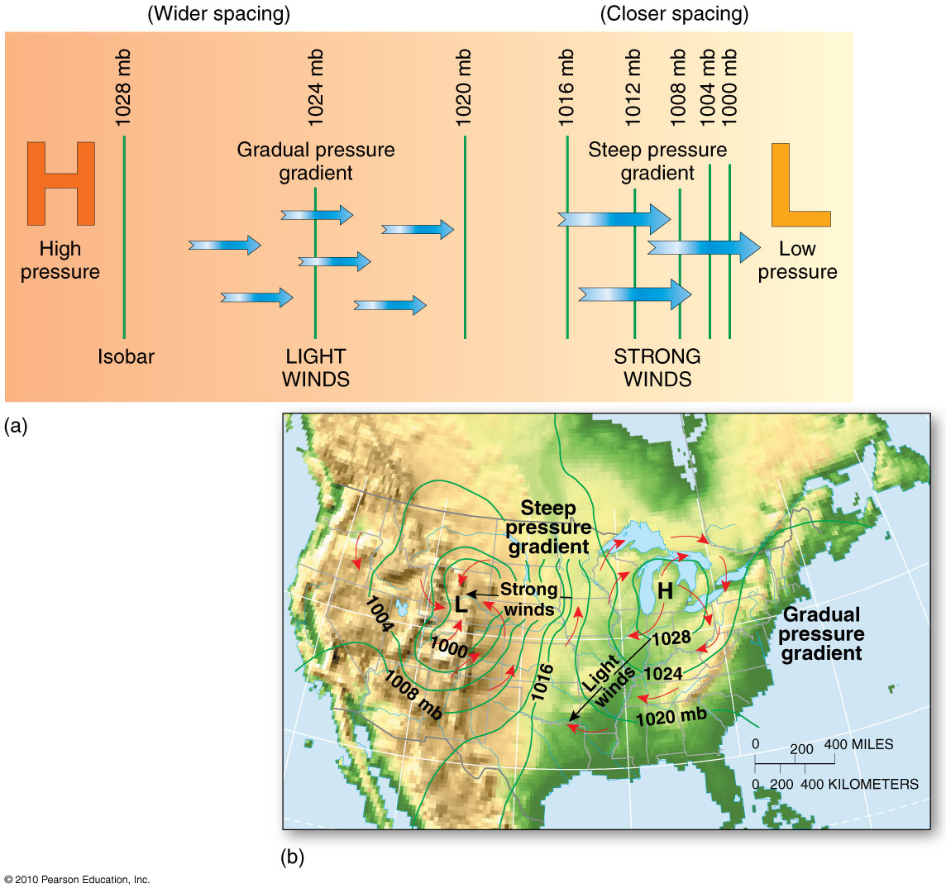
Pressure Gradient
Figure 4.7
Christopherson, Elemental Geosystems, Sixth Edition
Copyright © 2010 Pearson Education, Inc.

Slide 17
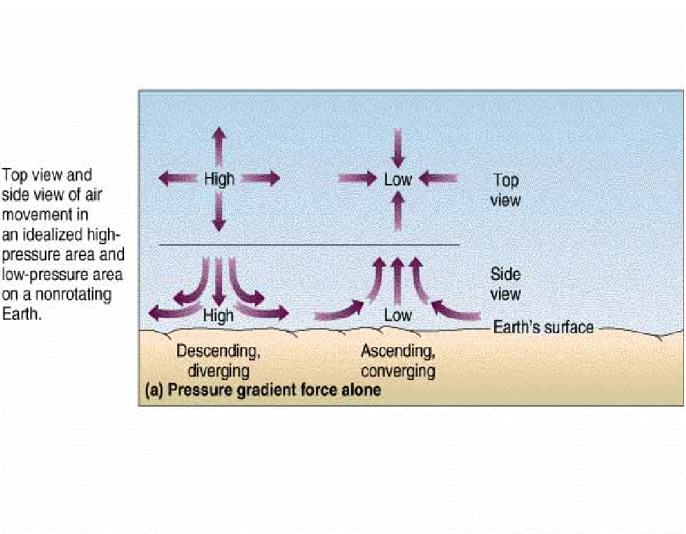
Convection
System
H
L
Pressure gradient force causes air to flow from an area of
high pressure to low pressure
Notes:
MUST KNOW ******************** High pressure = descend & diverge – dense, colder {friction warms it up} >>>>>> low pressure = warm

Slide 18
Driving Forces Within the Atmosphere
Coriolis Force (affects winds and ocean currents)
Deflects wind in a straight path in relation to Earth’s rotation in an easterly direction
Winds in the Northern Hemisphere are deflected toward the right while winds in the Southern Hemisphere are deflected toward the left
Zero along the equator and increasing to max. deflection flowing away from the poles

Slide 19
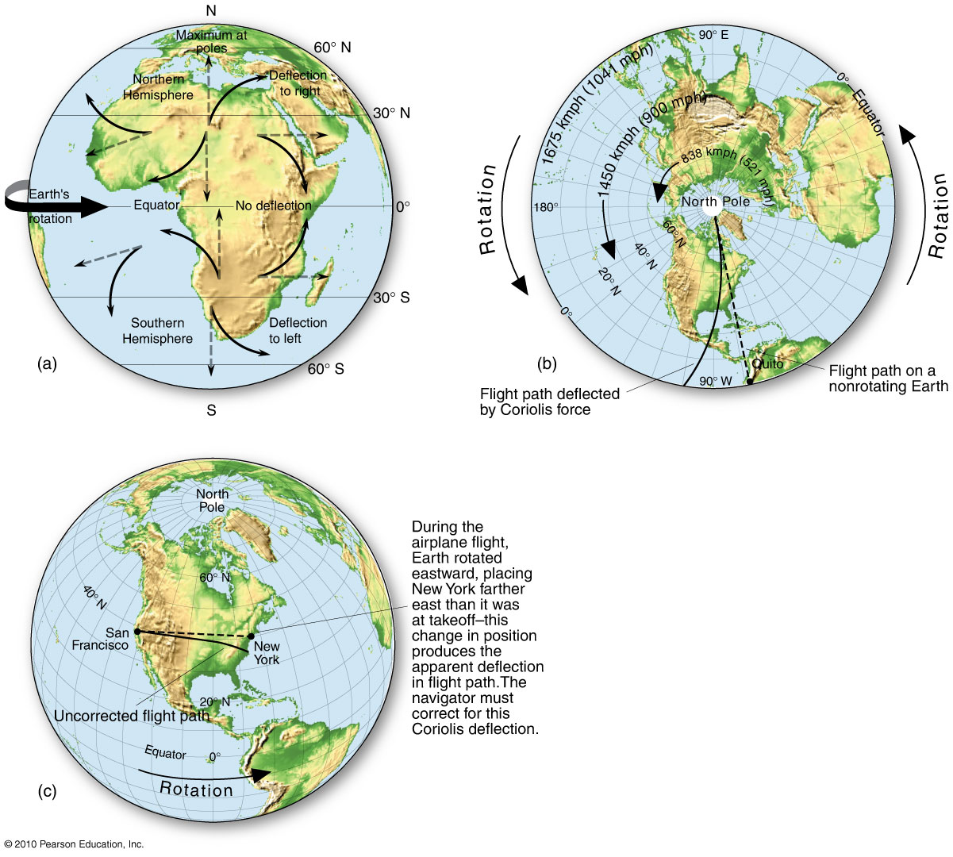
Coriolis Force
Figure 4.9
Christopherson, Elemental Geosystems, Sixth Edition
Copyright © 2010 Pearson Education, Inc.

Slide 20
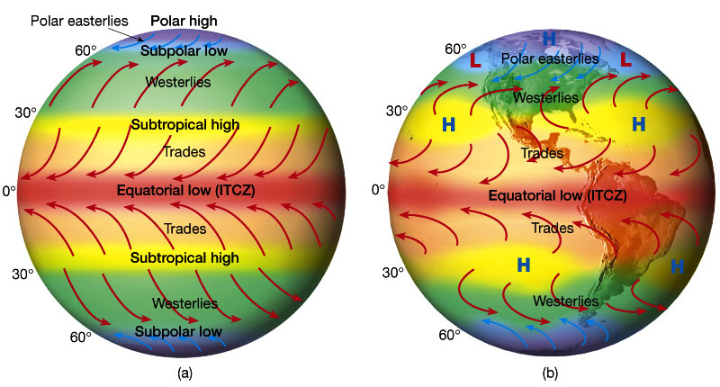
Pressure Gradient & Coriolis Force - earth rotation is cause

Slide 21
Driving Forces Within the Atmosphere
Friction Force
Effect of surface friction extends to a height of 500m
Varies with surface texture, wind speed, time of day and atmospheric conditions
Rougher surface produces more friction
Decreases wind speed and therefore the effect of Coriolis Force
Causes winds in the NH to move across isobars at an angle, spiraling out from high pressure areas clockwise to form an anticyclone and spiraling into low pressure areas counterclockwise to form a cyclone
In the SH, circulation patterns are reversed

Slide 22
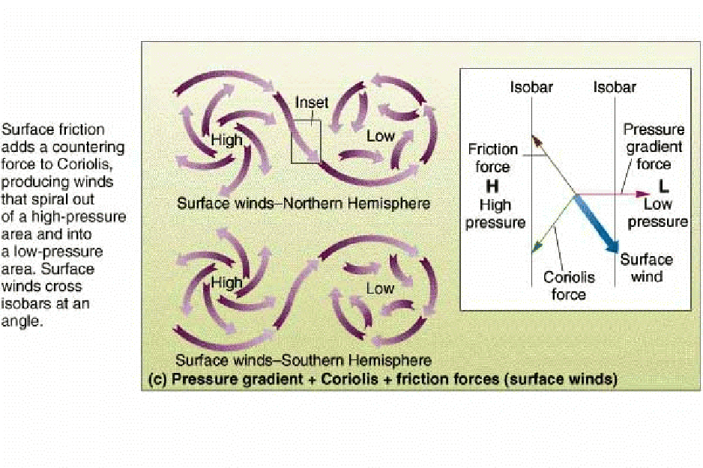
Effects of Pressure Gradient + Coriolis Force + Friction Force
Notes:
Anticyclone

Slide 23
Coriolis Force
Coriolis Force and the effect of winds aloft
in the upper troposphere, Coriolis force balances the pressure gradient force causing the winds between high-pressure and low-pressure systems to flow parallel to the isobars
produces geostrophic winds

Slide 24
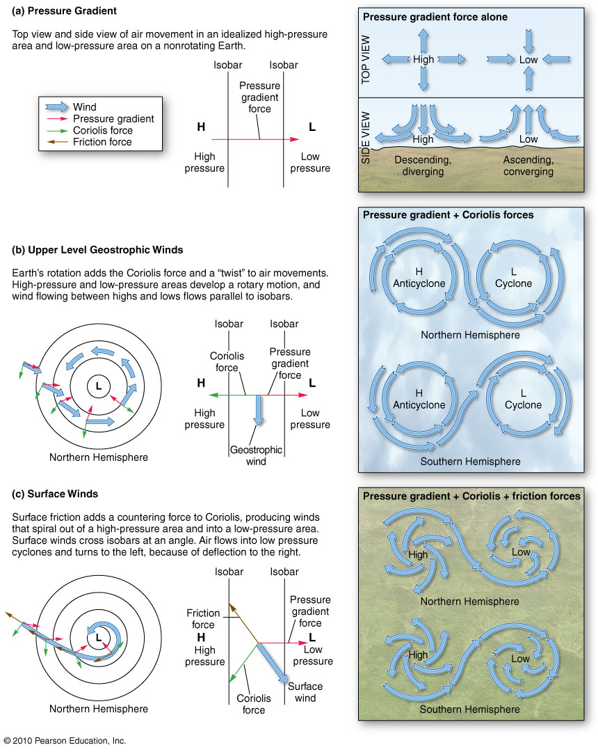
Pressure + Coriolis + Friction = Wind
Figure 4.8
Christopherson, Elemental Geosystems, Sixth Edition
Copyright © 2010 Pearson Education, Inc.

Slide 25
Atmospheric Patterns of Motion
Earth’s rotation produces a complex system of transfer of energy and air masses from equatorial surpluses to polar deficits
Primary High-Pressure and Low-Pressure Areas
Upper Atmospheric Circulation
Multiyear Oscillations in Global Circulation
Local Winds

Slide 26
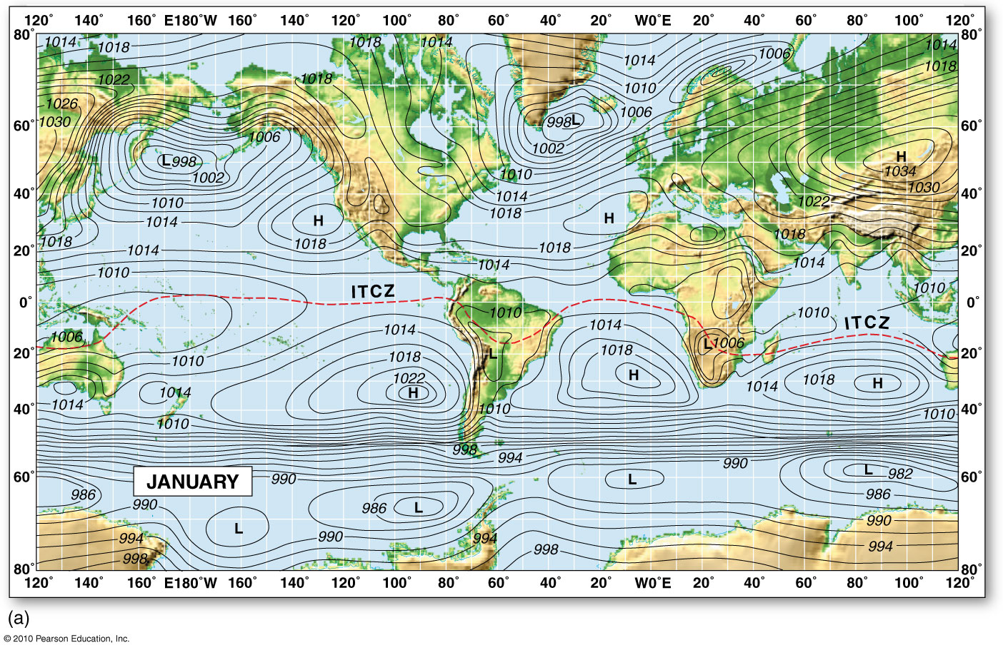
Global Barometric Pressure
Figure 4.10a
Christopherson, Elemental Geosystems, Sixth Edition
Copyright © 2010 Pearson Education, Inc.
Notes:
ITCZ follows low pressure , sun is in south hemisphere tropic of cancer

Slide 27
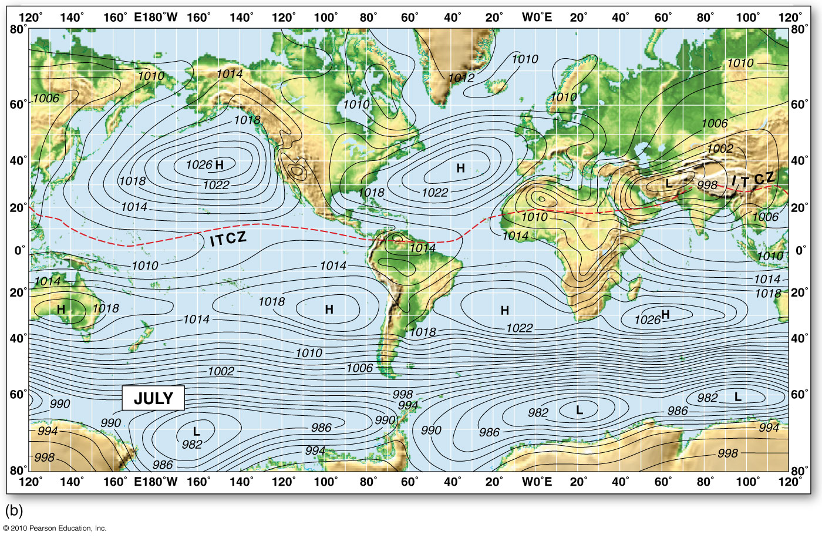
Global Barometric Pressure
Figure 4.10b
Christopherson, Elemental Geosystems, Sixth Edition
Copyright © 2010 Pearson Education, Inc.
Notes:
ITCZ the area is being warmed up, hottest are on earth low pressure zone, air is warmed up hot rising air forms low pressure system, hot air has moisture has lots of clouds
Atlantic ocean = azores
Pacific high 30 degree

Slide 28
Primary High-Pressure and Low-Pressure Areas
Equatorial Low-Pressure Trough
Elongated, narrow band of low pressure cloudiness & precipitation that girdles the Earth
ITCZ – Intertropical Convergence Zone
Warm wet air rushes into this low pressure zone and ascends
Cloud cover like a band of cloud
Subtropical High-Pressure Cells 20º – 35º
Hot, dry desert air
Air descends in these latitudes (continually pushed down by upper –air circulation)
It is heated as it compresses giving rise to the westerlies (higher latitudes) and the trade winds (lower latitudes)

Slide 29
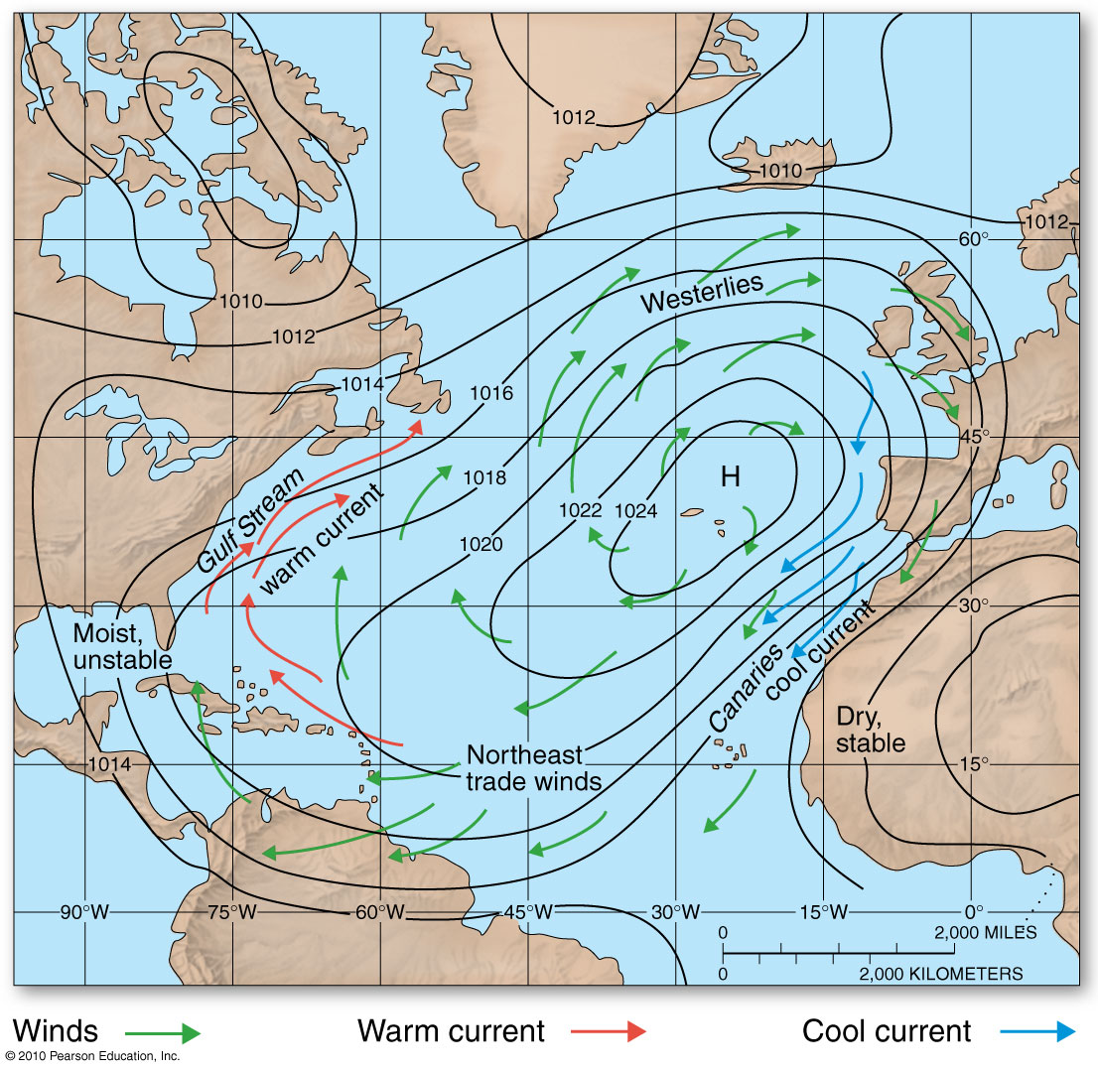
Subtropical High-Pressure Cells
Westerlies
Bermuda High
Azores High
Pacific High
Figure 4.13
Christopherson, Elemental Geosystems, Sixth Edition
Copyright © 2010 Pearson Education, Inc.

Slide 30
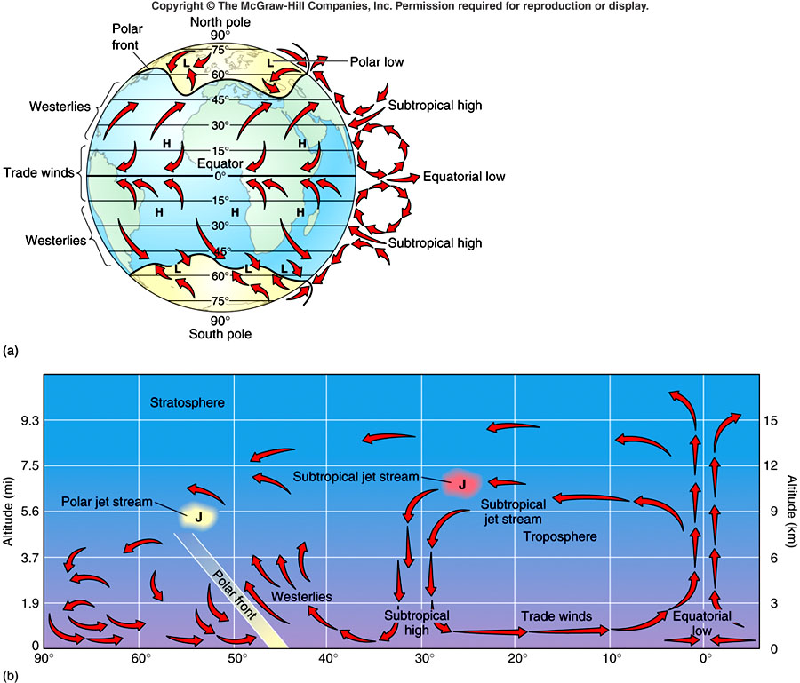
Equator-to-pole cross section for the Northern Hemisphere
Notes:
Hadley cell – (equator low and sub tropic high )== trade winds to equatorial low to subtropical jet stream to subtropical high
Trade winds blow to equator
Westerlies

Slide 31
Primary High-Pressure and Low-Pressure Areas
Subpolar Low-Pressure Cells – cool & moist air
2 low pressure cells over the oceans in January
Around 60ºN latitude
North Pacific – Aleutian low
North Atlantic - Icelandic Low
Contact zone between cold and warm air masses – polar front
Polar High-Pressure Cells – frigid dry deserts
Cold dry winds moving away from the poles
Descending and diverging clockwise in the NH
Forms the weak winds of the polar easterlies
Notes:
Warm and cold air meet forces warm air to rise = thunder storms, updraft, low pressure system

Slide 32
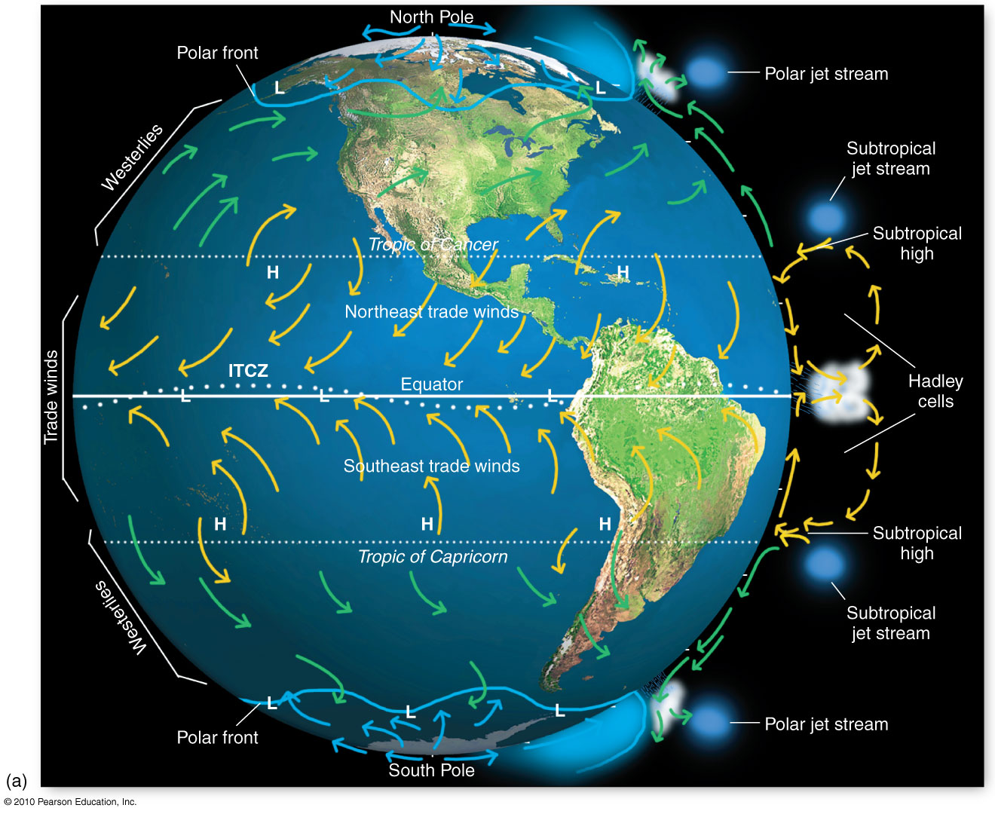
General Atmospheric Circulation
Figure 4.12a
Christopherson, Elemental Geosystems, Sixth Edition
Copyright © 2010 Pearson Education, Inc.

Slide 33
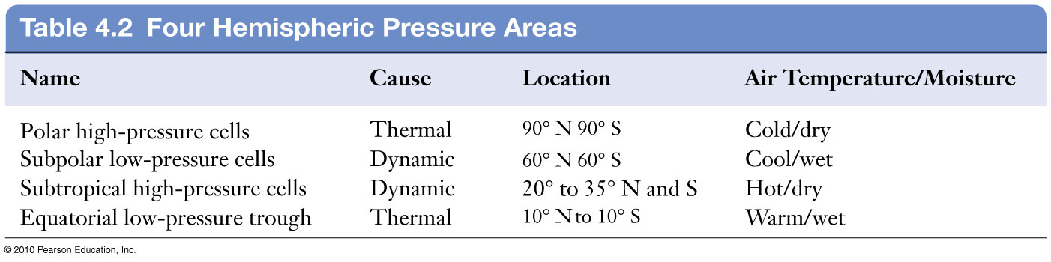

Slide 34
Upper Atmospheric Circulation
Using a 500-mb level to analyze upper-air winds – a pressure reference datum in the upper atmosphere
Ridges and troughs
Rossby waves – upper level westerly wind
Brings tongues of cold air southward, meeting warmer tropical air moving northward
Jet streams
Upper level westerly wind
Polar jet stream; 7,600 to 10,700m ~ 50º -70º N/S lat.
Subtropical jet stream 9,100 to 13,700m ~ 20º -50º N/S lat.
Located around the tropopause (~9km). No friction of air

Slide 35
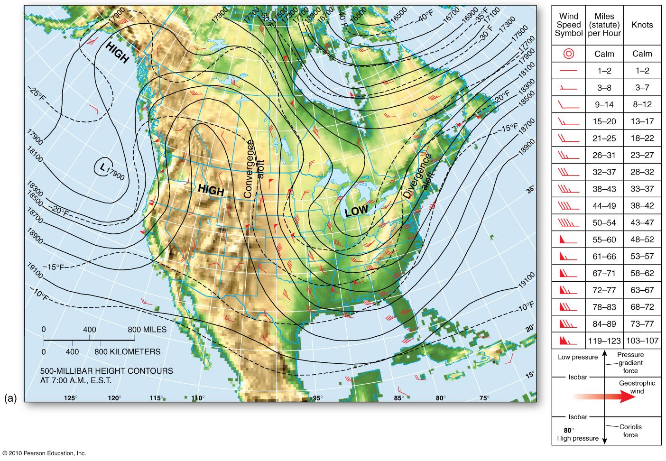
500-mb Pressure Map
Figure 4.15

Slide 36
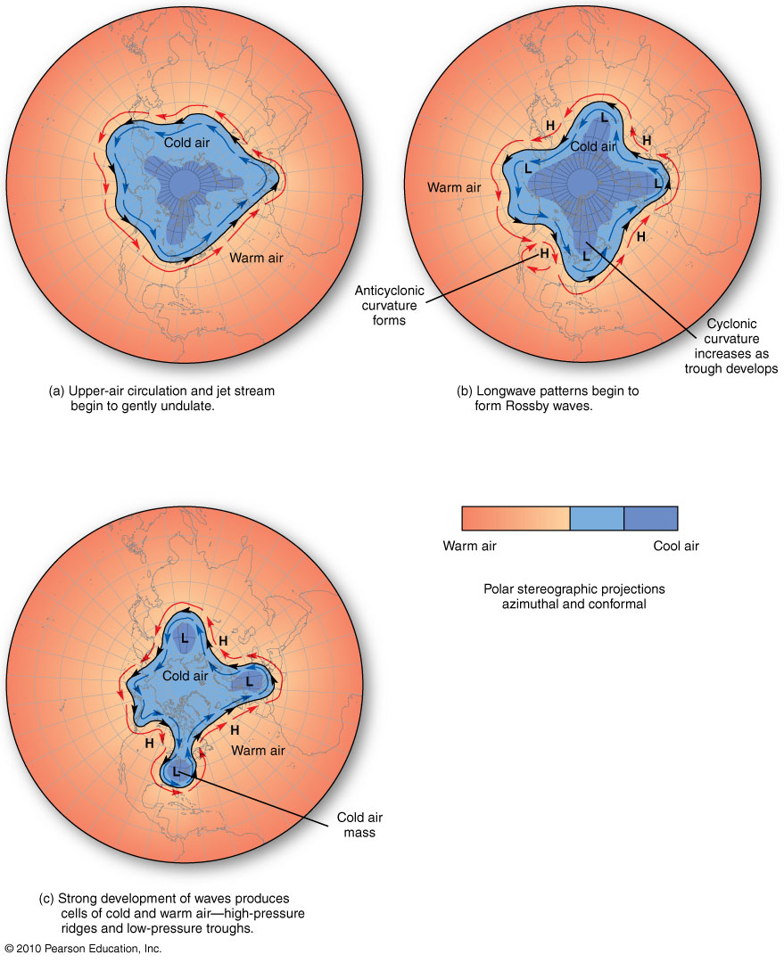
Rossby Waves
Figure 4.16
Christopherson, Elemental Geosystems, Sixth Edition
Copyright © 2010 Pearson Education, Inc.
Notes:
10,000 m above the surface

Slide 37
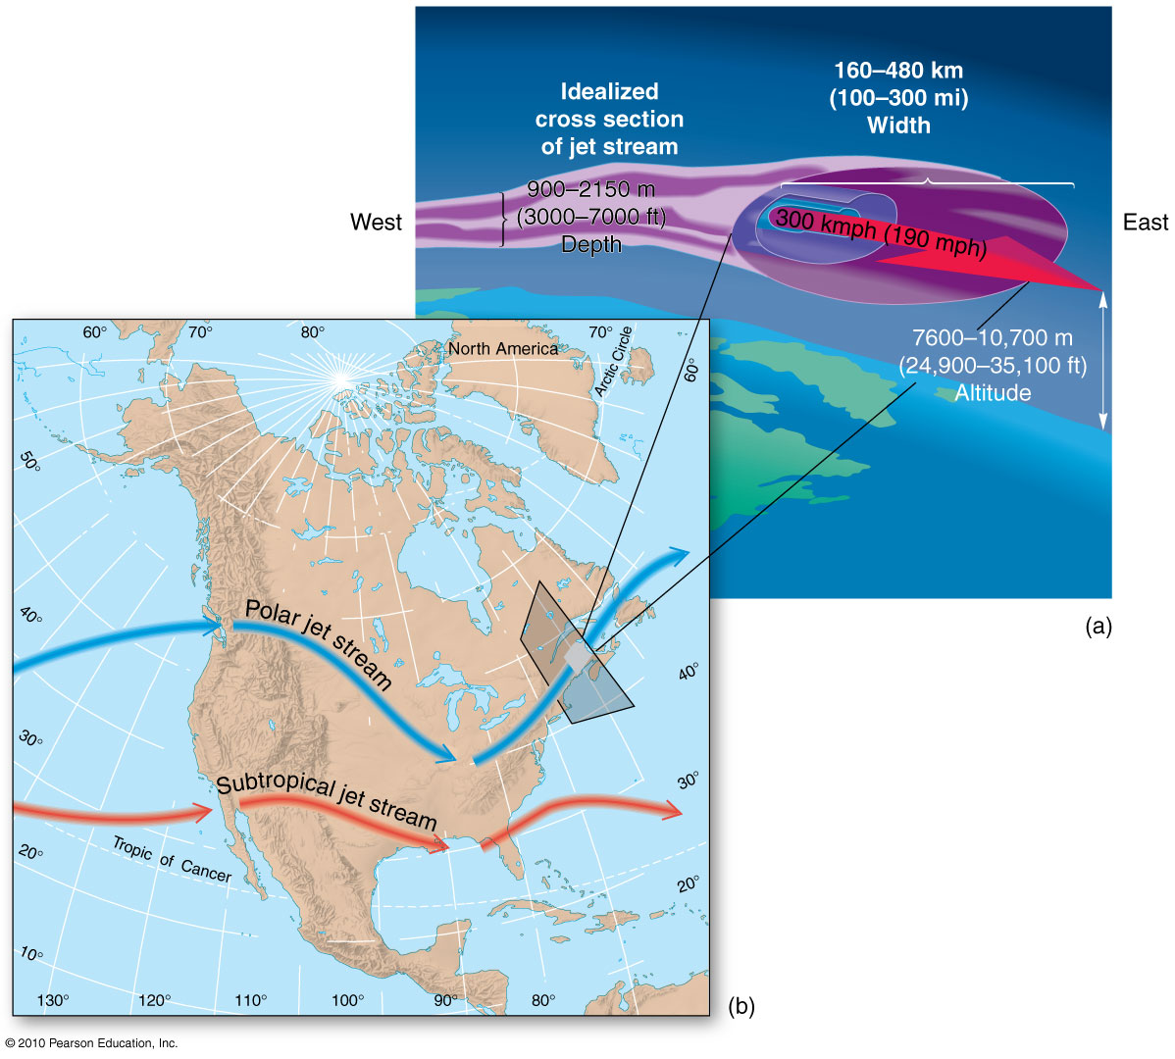
Jet Streams
Average location of 2 jet
streams over North America
Figure 4.17
Christopherson, Elemental Geosystems, Sixth Edition
Copyright © 2010 Pearson Education, Inc.

Slide 38
Multiyear Oscillations in Global Circulation
El Nino-Southern Oscillation (ENSO)
Described later in lecture
North Atlantic Oscillation (NAO) & Arctic Oscillation (AO)
Large scale mode of natural climate variability having huge impacts on the North Atlantic and surrounding regions and Arctic respectively
Both experience a positive phase and a negative phase

Slide 39
North Atlantic Oscillation
Positive Phase
Icelandic low pressure system is lower in pressure than normal
Azores subtropical high pressure system is stronger than normal
Results in more and stronger winter storms crossing the Atlantic Ocean on a more northerly track
warm and wet winters in Europe and cold and dry winters in northern Canada and Greenland
the eastern US experiences mild and wet winter conditions

Slide 40
North Atlantic Oscillation
Negative Phase
shows a weak subtropical high and a weak Icelandic low
The reduced pressure gradient results in fewer and weaker winter storms crossing on a more west-east pathway
They bring moist air into the Mediterranean and cold air to northern Europe
The US east coast experiences more cold air outbreaks and hence snowy weather conditions.
Greenland, however, will have milder winter temperatures

Slide 41
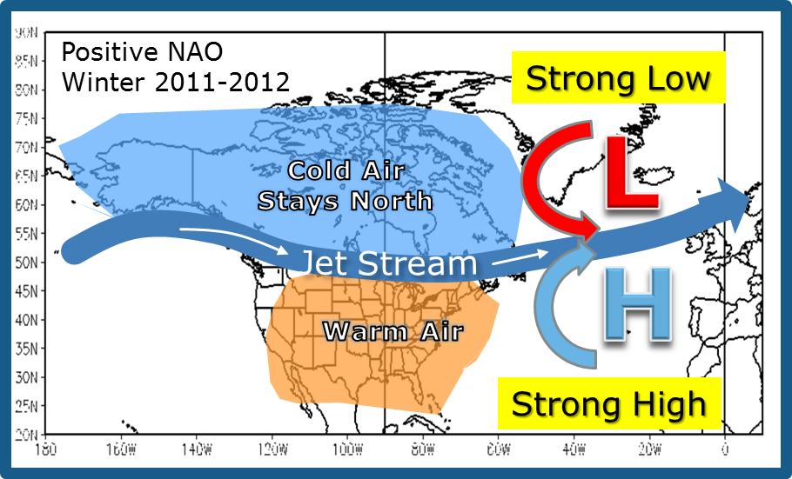
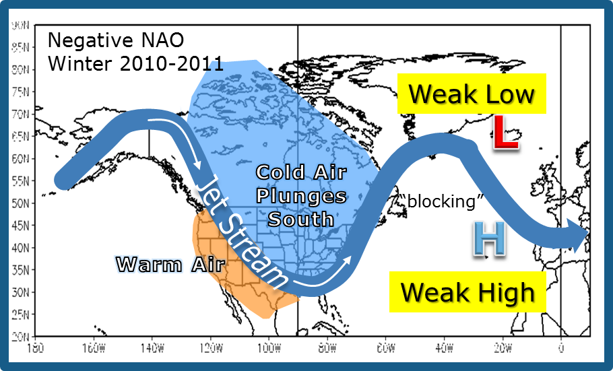

Slide 42
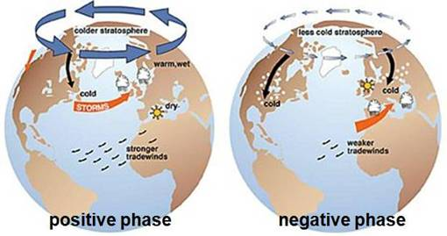
High & Low pressure systems stronger
Stronger west to east Jet stream
cross the eastern Atlantic
Colder winds stay up north in Canada and Alaska
Northerly winds blow in the Labrador Sea
Southerly winds move through the Norwegian Sea
Weaker High and low pressure systems than normal
Jet stream tends to ‘buckle’ more across eastern NA
Colder Northerly winds from the arctic move way southward
Southerly winds move inland toward Europe

Slide 43
Multiyear Oscillations in Global Circulation
Arctic Oscillation (AO)
Associated with the NAO especially in winter
Produces 2 phases of the AO Index which correlates to the 2 phases of the NAO
warm phase
cold phase
Pacific Decadal Oscillation
20 – 30 year oscillation in the pacific Ocean
2 regions of sea-surface temperatures: #1 the northern and tropical western Pacific and #2 the eastern tropical Pacific, along the west coast

Slide 44
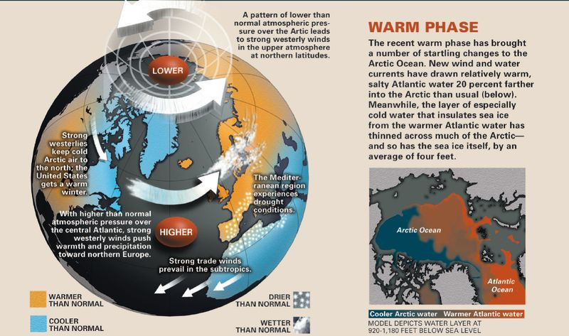
Arctic Oscillation – warm phase

Slide 45
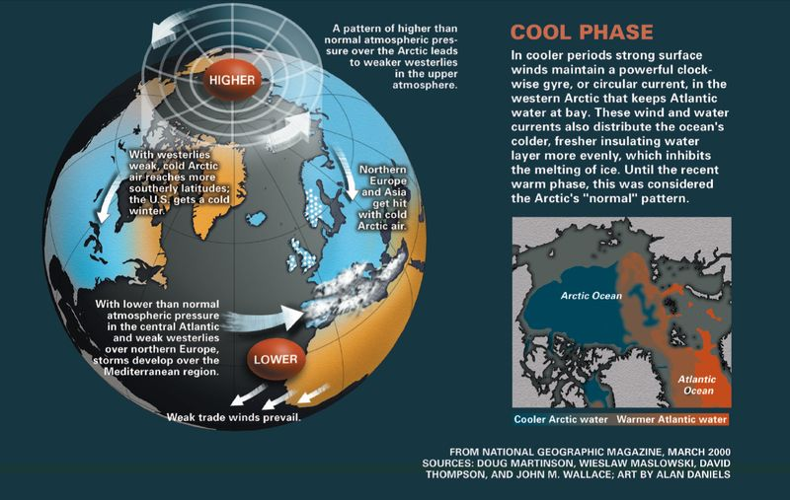
Arctic Oscillation – cool phase

Slide 46
Local Winds
Land–Sea Breezes
Mountain–Valley Breezes
Katabatic Winds
ferocious winds that blow off the ice sheets of Antarctica and Greenland
Monsoonal Winds
Regional wind systems – those over southeast Asia, Indonesia, India, northern Australia, equatorial Africa & southern Arizona

Slide 47
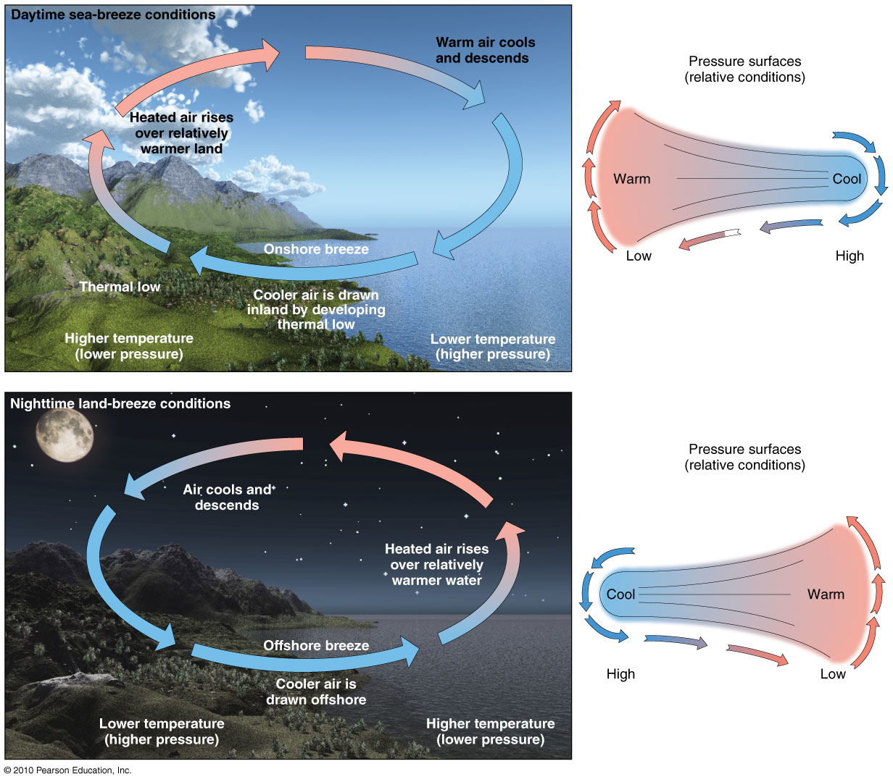
Land–Sea Breezes
Figure 4.18
Christopherson, Elemental Geosystems, Sixth Edition
Copyright © 2010 Pearson Education, Inc.

Slide 48
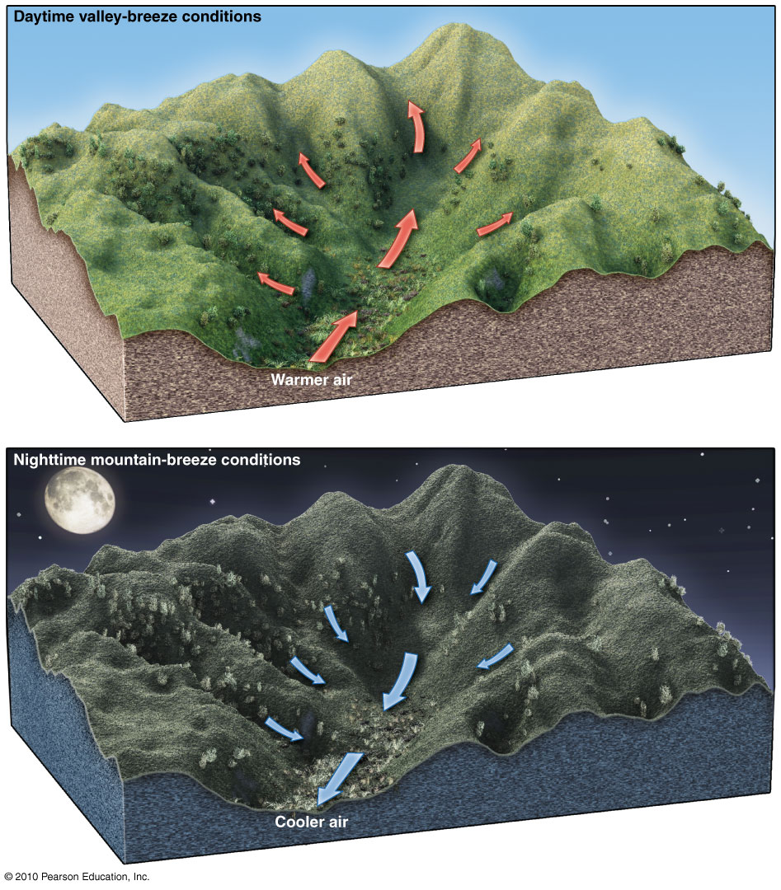
Mountain– Valley Breezes
Figure 4.19
Christopherson, Elemental Geosystems, Sixth Edition
Copyright © 2010 Pearson Education, Inc.

Slide 49
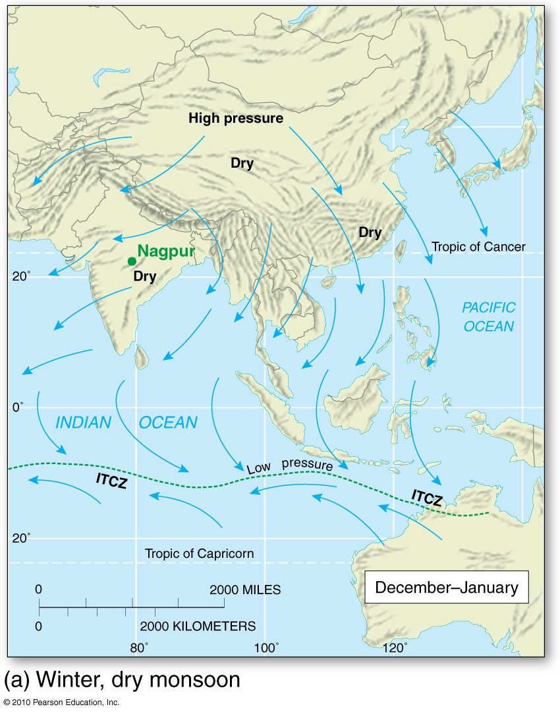
The Asian Monsoon
Figure 4.20
Christopherson, Elemental Geosystems, Sixth Edition
Copyright © 2010 Pearson Education, Inc.

Slide 50
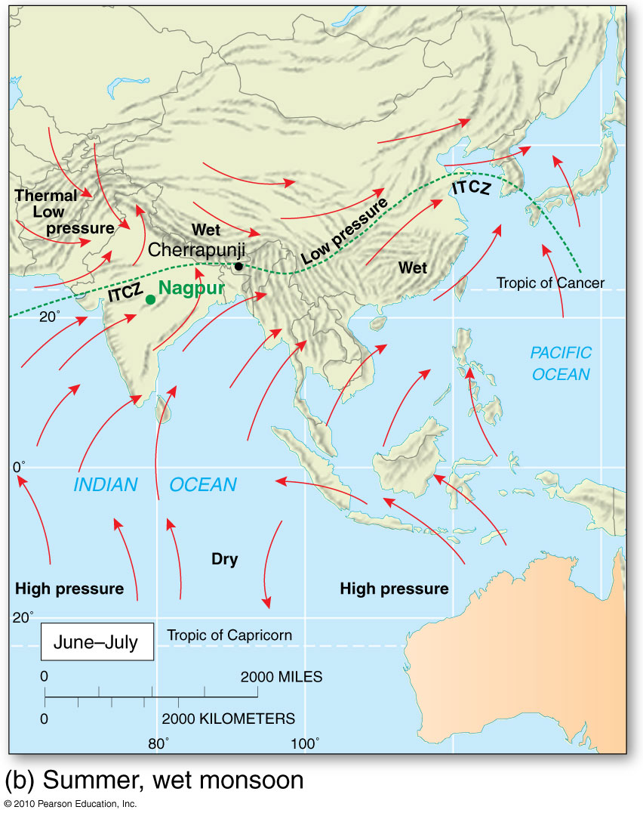

Slide 51
Oceanic Currents
Earth’s atmosphere & oceanic circulations are closely related
Oceanic circulation
driving force for ocean currents is the frictional drag of the winds
driven by differences in density & pressure
along with Coriolis force
differences in salinity
configuration of the continents
ocean floor

Slide 52
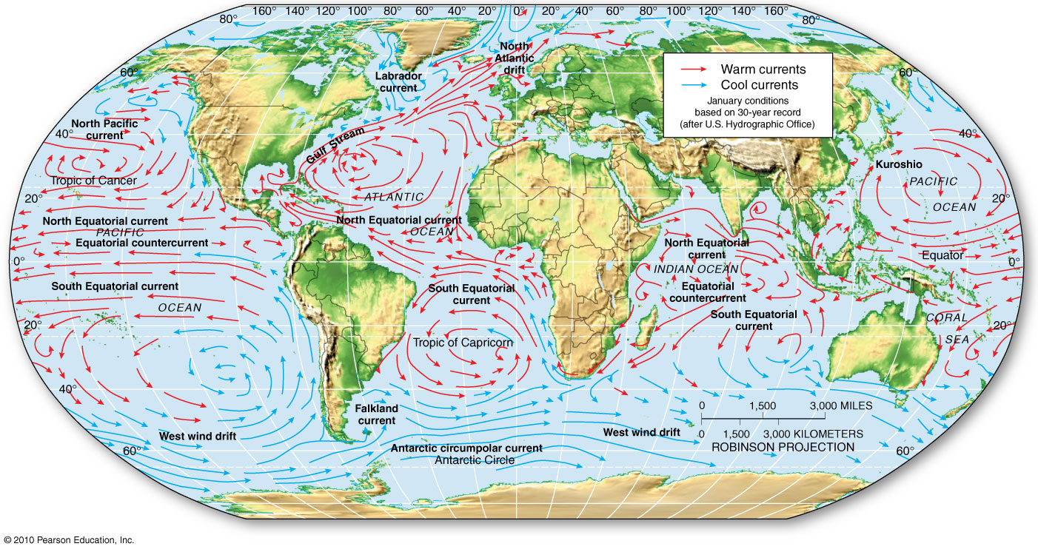
Major Ocean Currents
Figure 4.21
Gyres, western intensification

Slide 53
Oceanic Currents
Surface Currents
Driven by the circulation around sub-tropical high-pressure cells in both hemispheres; in the NH called gyres
Remember: winds and ocean currents move clockwise in the NH and counter-clockwise in the SH
Western intensification; piling up of water on the western margins of the oceans
Water spills to the north – Gulf Stream and the Kuroshio

Slide 54
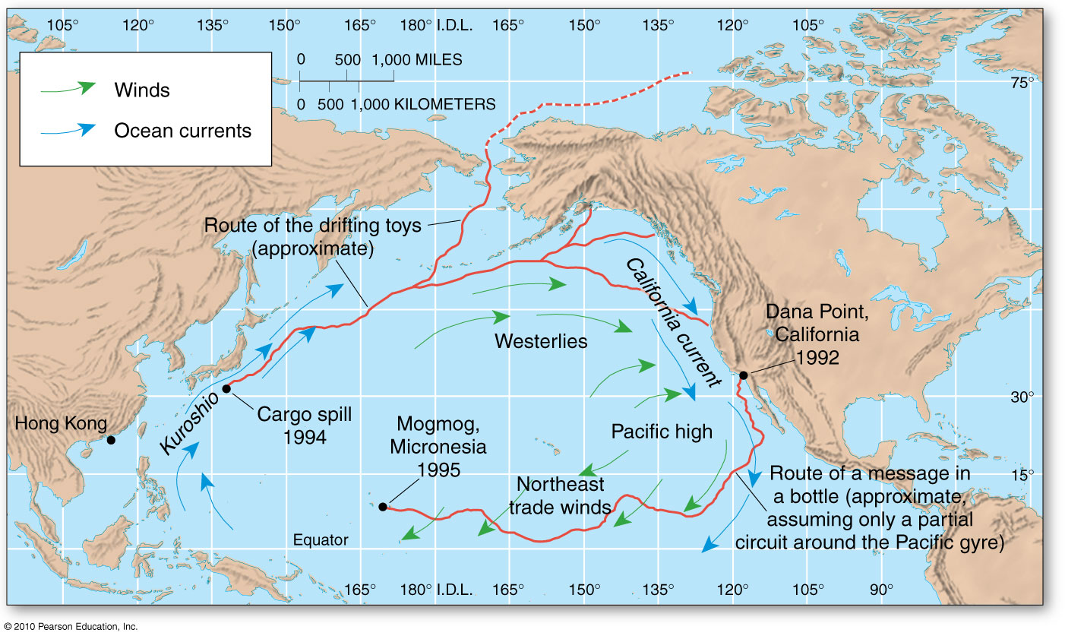
Pacific Ocean Currents
Figure NR 4.3.1
Christopherson, Elemental Geosystems, Sixth Edition
Copyright © 2010 Pearson Education, Inc.

Slide 55
Oceanic Currents
Upwelling and downwelling flows
Upwelling current – cool, nutrient rich
Exist off the Pacific coasts of North & South America
Subtropical and midlatitude west coast of Africa
Earth’s prime fishing regions
Downwelling flows – accumulation of water, excess water gravitates downward – deep currents that flow vertically and along the ocean floor carrying heat energy and salinity
Thermohaline circulation ― The deep currents
Differences in temperature and salinity causes density variations that give rise to the flow of deep currents

Slide 56
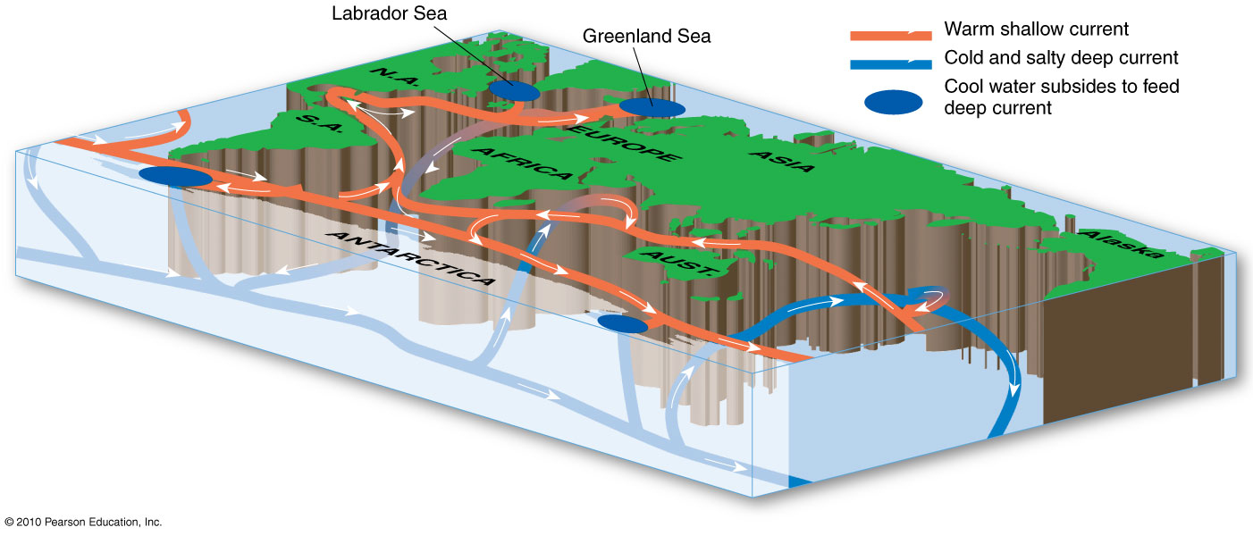
Thermohaline Circulation
Figure 4.22
Christopherson, Elemental Geosystems, Sixth Edition
Copyright © 2010 Pearson Education, Inc.

Slide 57
End of Lecture
Next Lecture
Chapter 5

